Slide 1
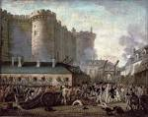
CAUSES FOR FRENCH REVOLUTION 1789

Slide 2
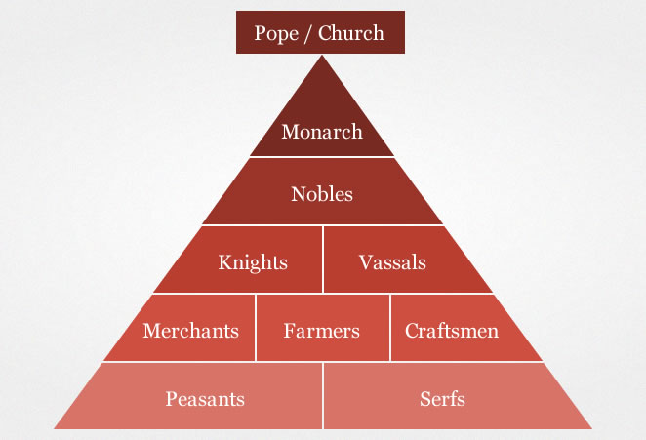
SOCIAL CAUSES
Feudalism

Slide 3
ADMINISTRATIVE CAUSES
Rotten System
Centralised
Family Influence
No Uniform Law
Cruel Laws
Severe Punishments
Military Rank System
Tax Collection (Bidding)

Slide 4
POLITICAL CAUSES
Louis XIV: Absolute Monarch
Louis XV: Warfare Monarch
Louis XVI: Maladministrative Monarch

Slide 5
INTELLECTUAL CAUSES
Montesquieu : Separation of Powers
Voltaire : Freedom of Religion, Freedom of Expression, Separation of Church and State
Rousseau : State of Nature, Social Contract
Helvetius : Character of Nations
Holbach : System of Nature

Slide 6
FINANCIAL CAUSES
Wars of Rulers : Louis XIV, Louis XV, Louis XVI
Financial Bankruptcy : Borrowings
Tax System : No Tax for Upper Class
Finance Control : Turgot, Necker, Calonne

Slide 7
IMMEDIATE CAUSES
Summoning of Assembly of Nobles in 1787
Convention of Estates General in 1789 (1614-1789=175 Years)
Starvation and Cry for Food

Slide 8
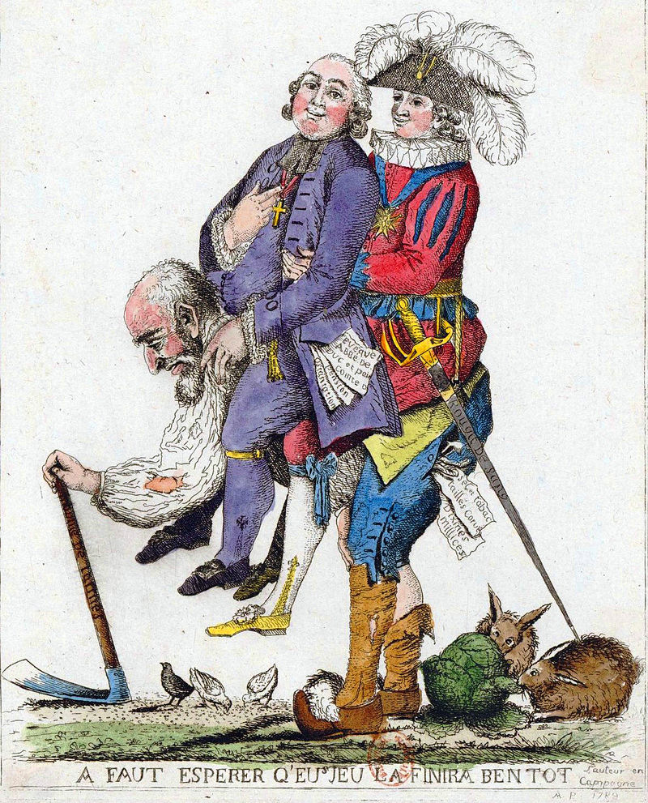
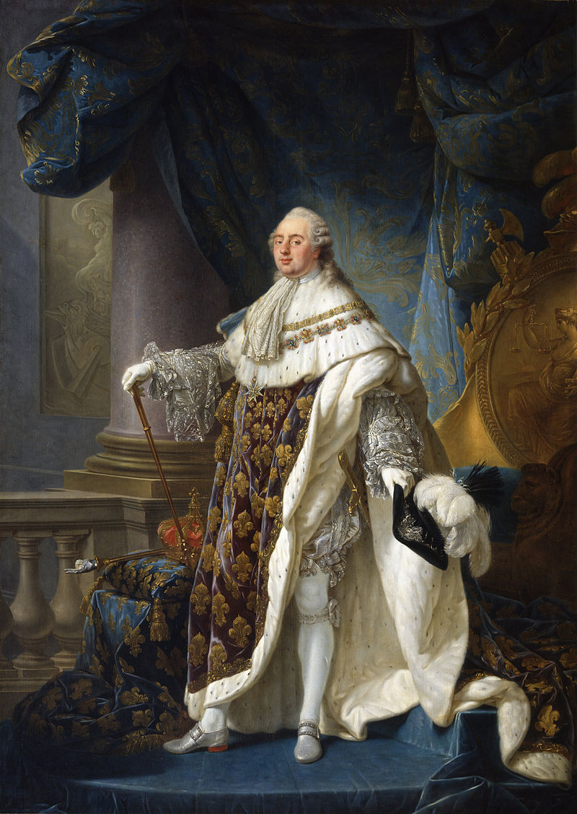

Slide 9
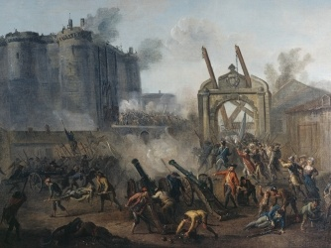
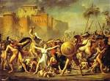

Slide 10
